Slide 1
Milestone 3 Presentation
Peter Schubert, Monier Abdullah, Jeffrey Fishman, Khalid Saeed

Slide 2
Team Workload
Dividing work
Relatively easy to do
Many parts to do to allow for equal cooperation
Some tasks expanded beyond initial estimates, and the work needed to be rebalanced
Difficult part was keeping track
Would say it verbally though not everyone remembers
Came up with a sheet and updated it continuously outlining the work of each team member
Peter

Slide 3
Team Lead
Difficult position
Organizing and leading each of the team meetings
Occasionally seems like I’m talking to myself
Request input from other team members and assign
Directing the group in the correct direction
Difficulty attempting to translate from what is talked out in class
Better to ask everyone to rewatch recordings or go to Prof. Steiner during office hours as a team
Hear it directly from Professor and everyone understands
Rotating meeting leaders
We recently started trying out rotating meeting leaders so accountability and responsibility of keeping everything efficient and on-topic wasn’t solely on the Team Lead
Peter

Slide 4
SPMP-Milestone 1-LOC Estimate
Technique
Estimated Lines of Code / Estimate Hours = LOC per hour
1000 LOC / 200 hours = 5 lines per hour
Initial LOC estimate: 1000 lines of code
Initial Hours estimate: 200 hours
Estimation based on initial estimates based on the specifications of the project charter
Peter

Slide 5
SPMP-Milestone 1- Function Points
Function Point | Complexity | Number
External Inputs | 3 | 12
External Outputs | 9 | 15
External Inquires | 8 | 11
Internal Logical Files | 5 | 5
Total FP: 284
3 hours per point
284*3 = 852 hours

Slide 6
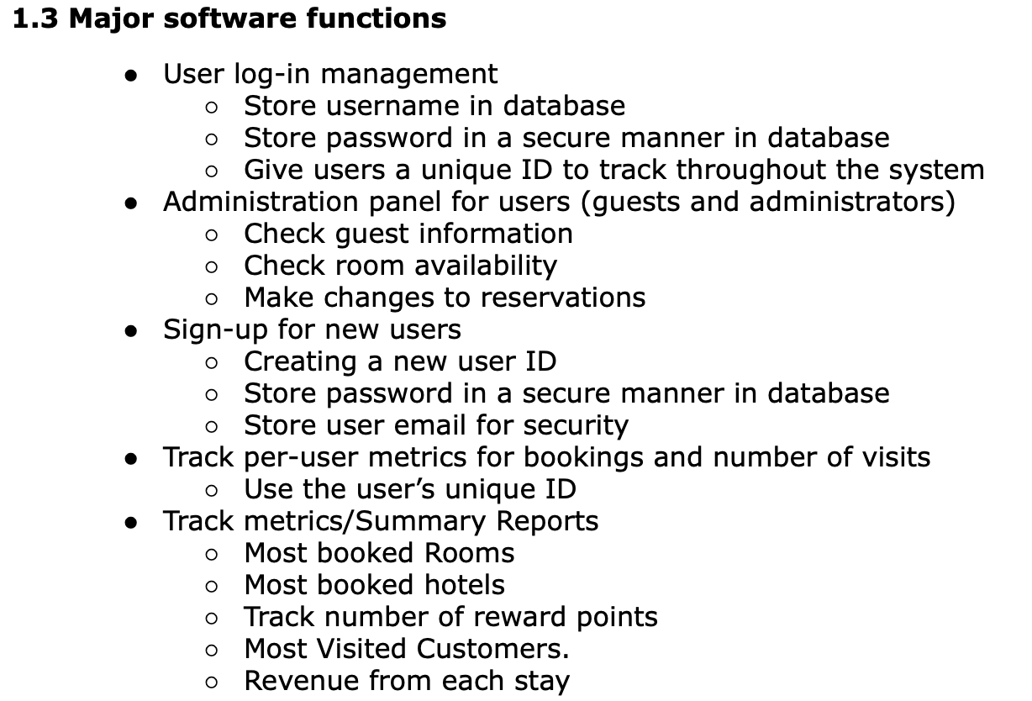
SPMP-Milestone 1-Function Estimate
Function estimate: 15
Based on details gathered initially from the Project Charter and assumptions
Peter

Slide 7
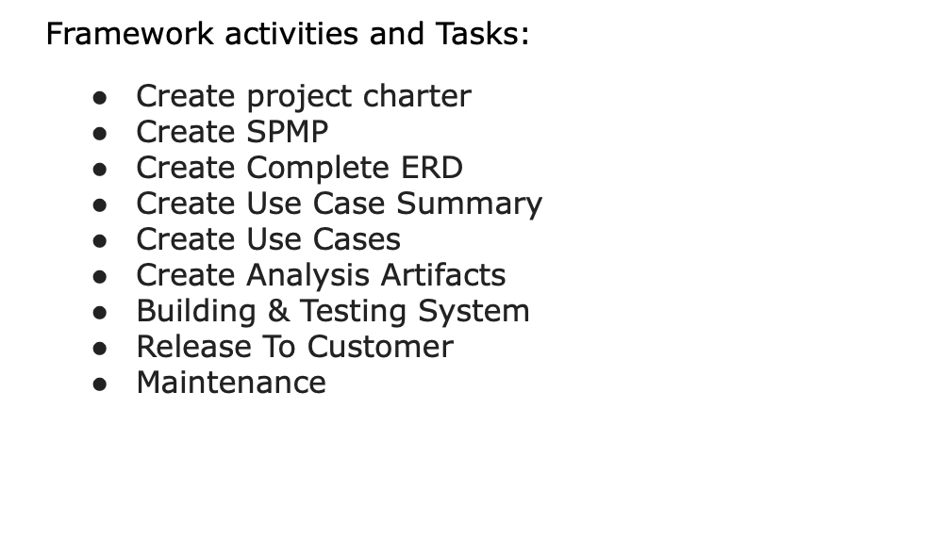
SPMP-Milestone 1-Tasks
Based on Initial outlined tasks for the semester
Milestone 1:Project Charter , SPMP, ERD
Milestone 2: Use Case Summary
Milestone 3: Use Case Specification Documents
Milestone 4: Analysis Artifacts
Build, Test, and Maintain
Peter

Slide 8
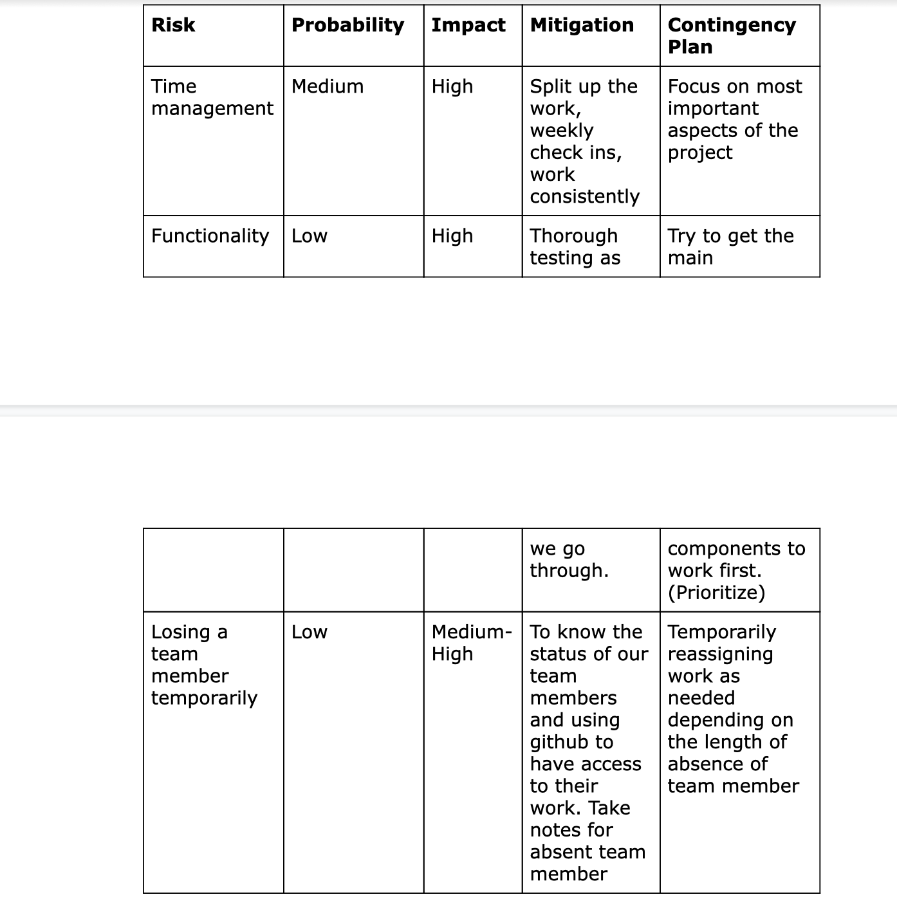
SPMP-MIlestone 1-Risks
Initial risks identified Time management, reworking functionality and losing a team member
Not much information initially based on what we were planning on doing
Major risks that did not factor in planning risks
Peter

Slide 9
SPMP Milestone 2-3-LOC Estimate
Technique
Estimated Lines of Code / Estimate Hours = LOC per hour
3000 LOC / 200 hours = 5 lines per hour
New LOC estimate: 3000 lines of code
New Hours estimate: 1000 hours
Estimation based on developing the flows in the use case specification documents
Reservation use case seemed the most complex and detailed
Peter

Slide 10
Milestone 3 Function Points
Function Point | Complexity | Number
External Inputs | 3 | 13
External Outputs | 9 | 15
External Inquires | 8 | 11
Internal Logical Files | 5 | 5
Total FP: 297
3 hours per point
284*5 = 891 hours

Slide 11
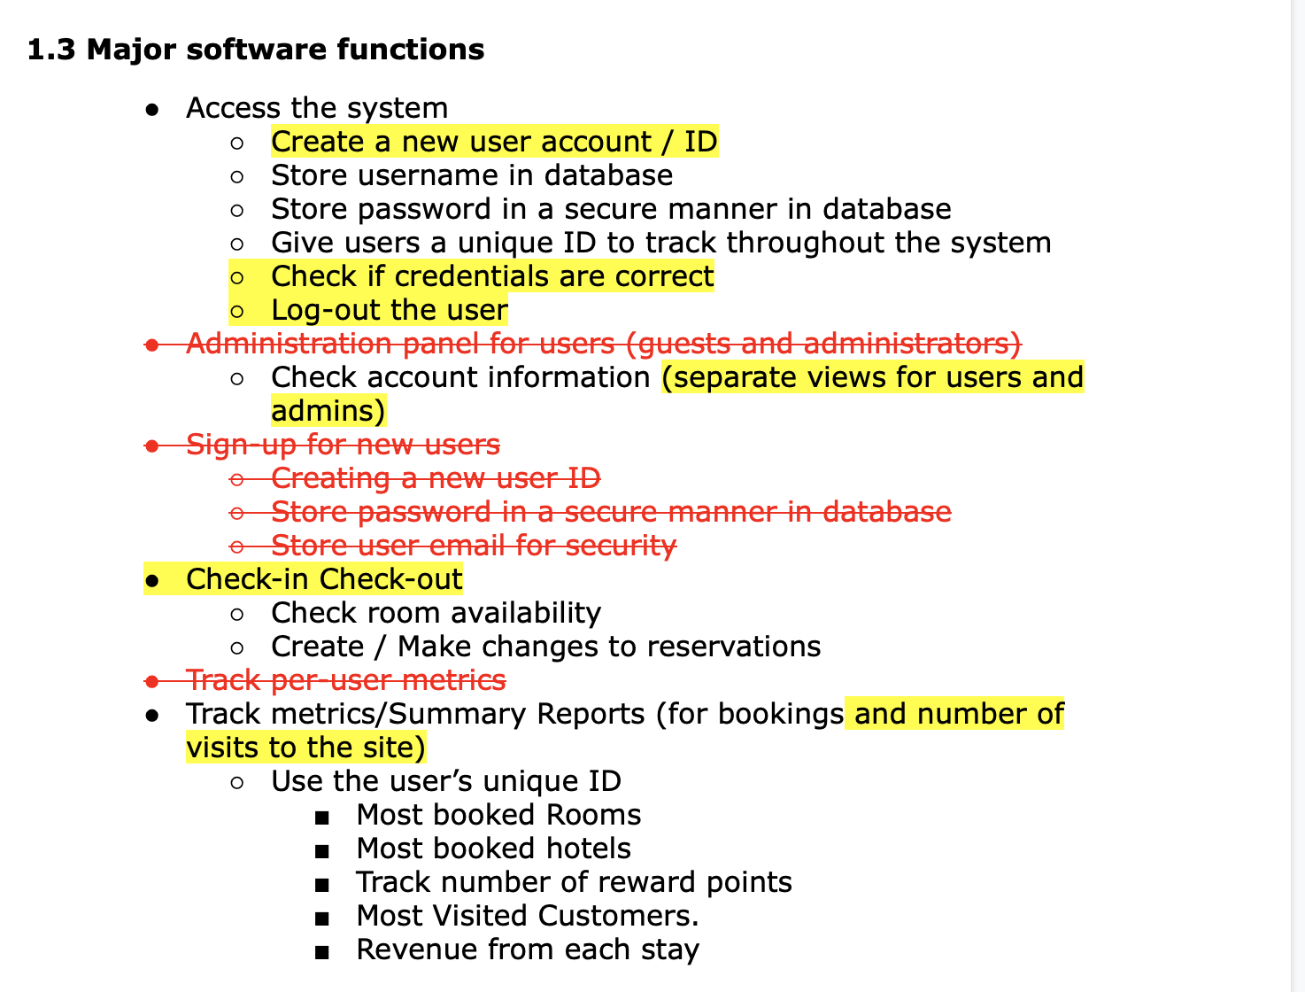
SPMP Milestone 2-3 Function Estimate
Function estimate: 15
Same number of functions
Some were eliminated and added
Corrections made on adjustments to use cases and corresponding functionality from new information received from Wednesday Meetings
Peter

Slide 12
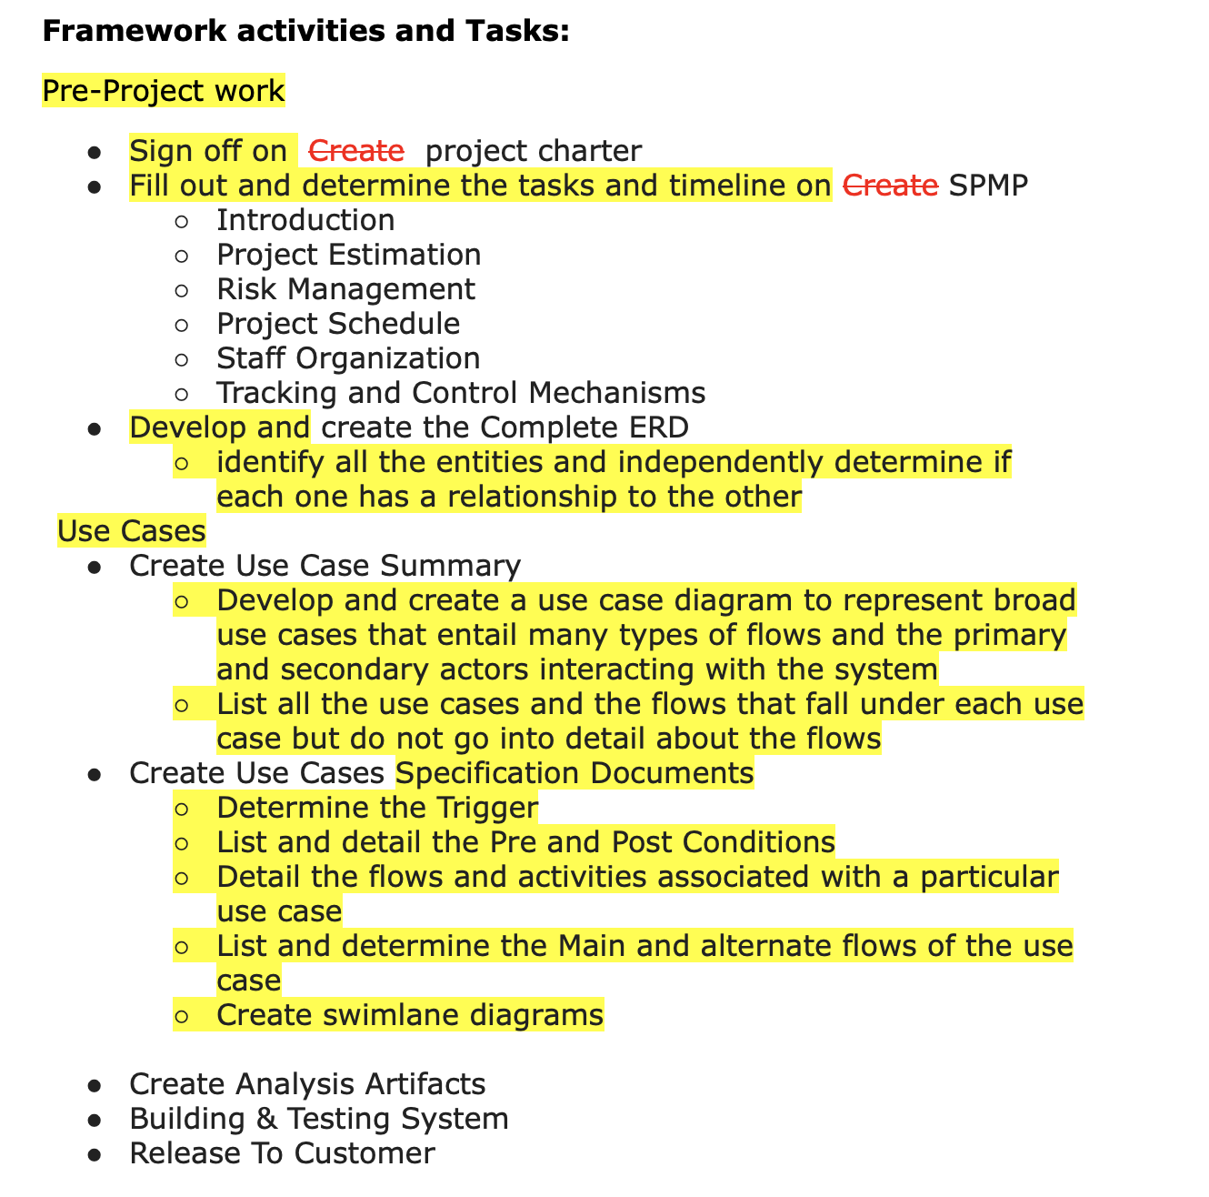
SPMP-Milestone 3-Tasks
As time progressed, more sub-tasks were identified that needed to be completed
Especially true when it came to developing the use case summary and each of the specification documents
I.e. creating a diagram, listing each use case, identifying the corresponding flows etc.
Tasks for future milestones will be identified as we get closer to them
Peter

Slide 13
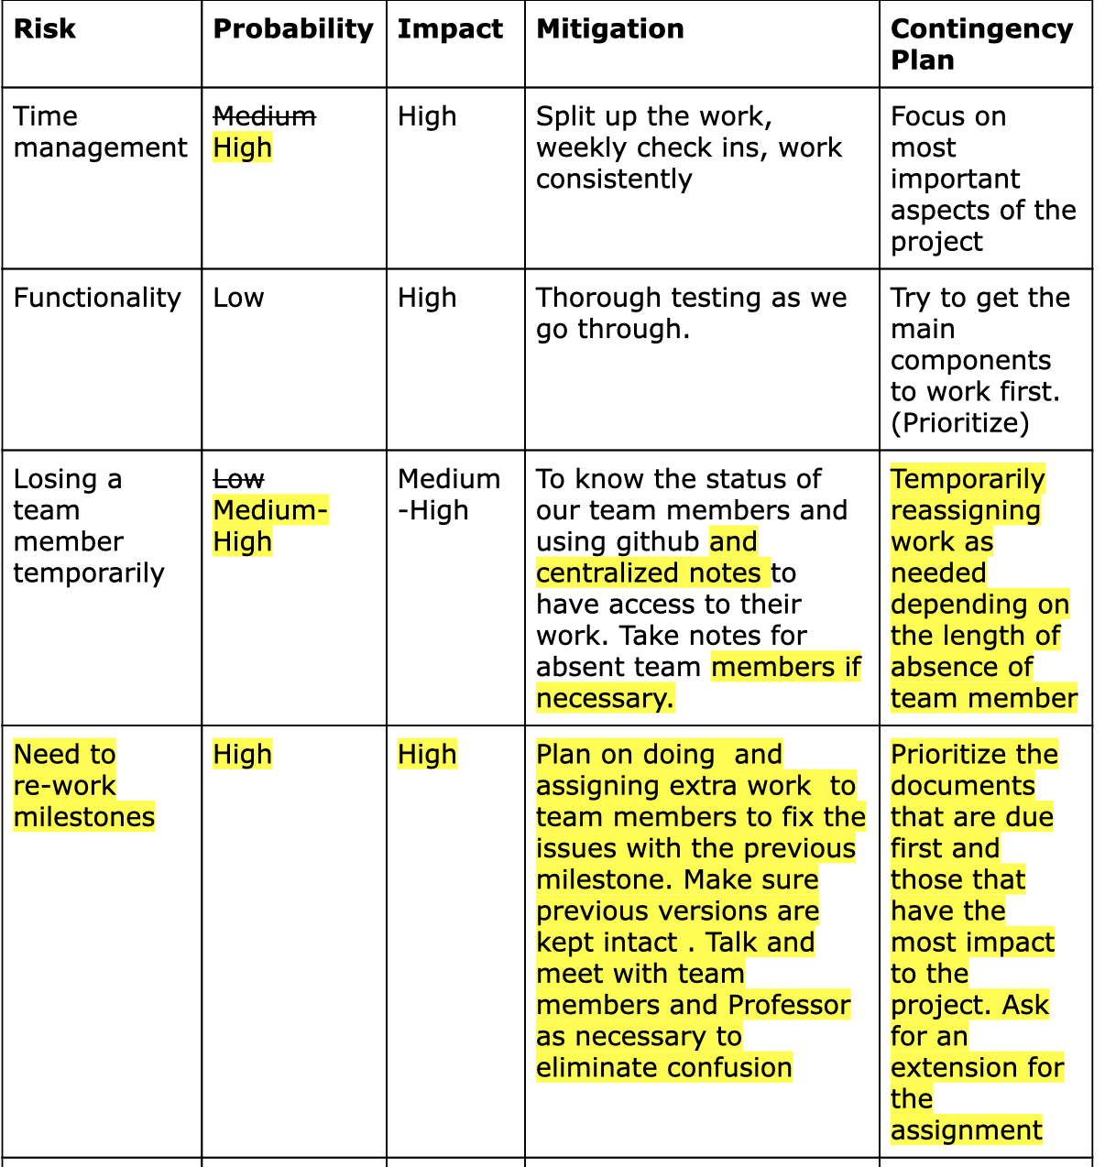
SPMP-Milestone 3-Risks
Additional risk “Need to re-work milestones” as added after Team lead meeting
Did not anticipate having to re-work some of the milestones due to them being incorrect
Made modifications to others re-assessing the risk and the mitigation / proactive measure to help lessen the risk
Peter

Slide 14
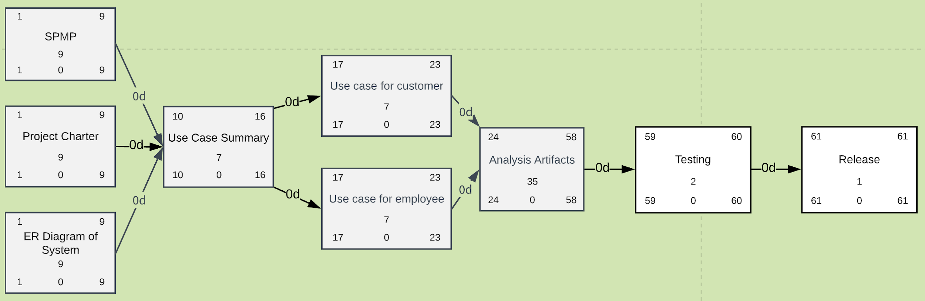
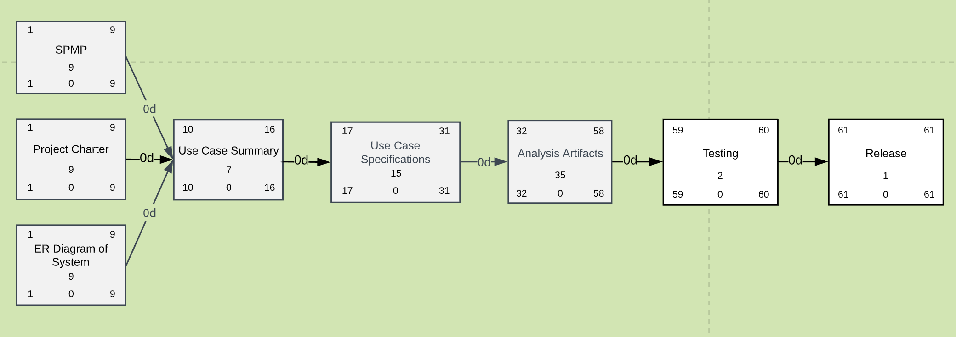
Task Network Diagram
We thought it best to have the diagram follow major milestone tasks and dates
Only underwent one revision for a shift in Use Case delivery date
Intent was to build it out and parallelize as many tasks as possible, but we found the dependencies and successors didn’t favor that structure
Jeff

Slide 15
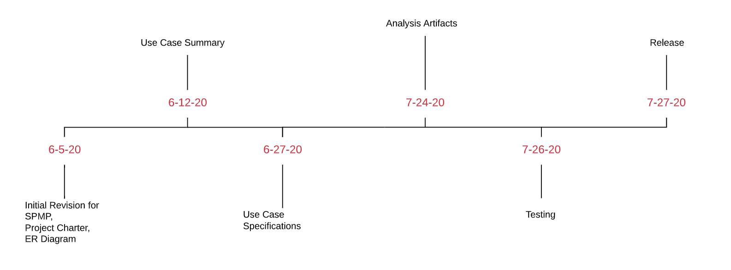
Timeline Diagram
Similar to the Task Network Diagram, there was only one revision made for a shift in Use Case delivery date
Built using the Task Network diagram as a base
Jeff

Slide 16
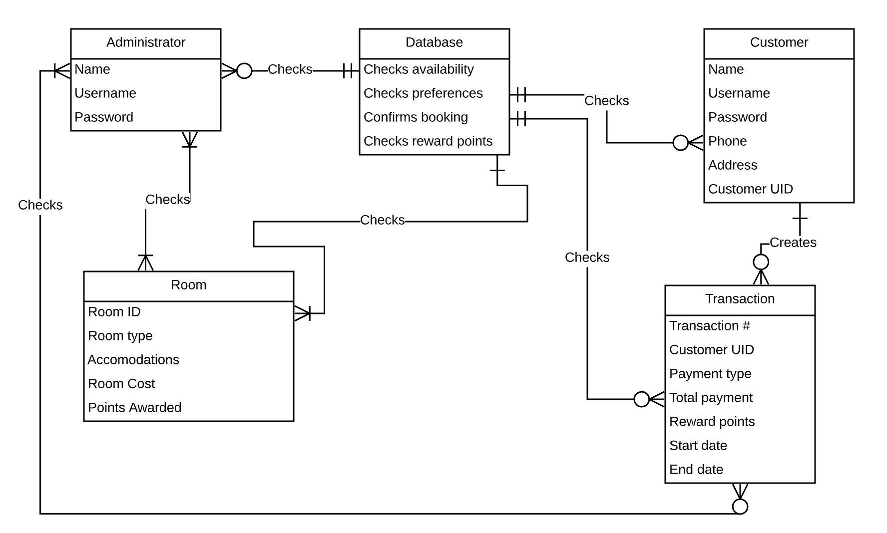
Milestone 1 Complete ERD
Version 1 of our ERD was created initially to describe the interactions between our original entities.
An issue that came to our attention was that our approach to the ERD was similar to that of a Class Diagram.
Monier

Slide 17
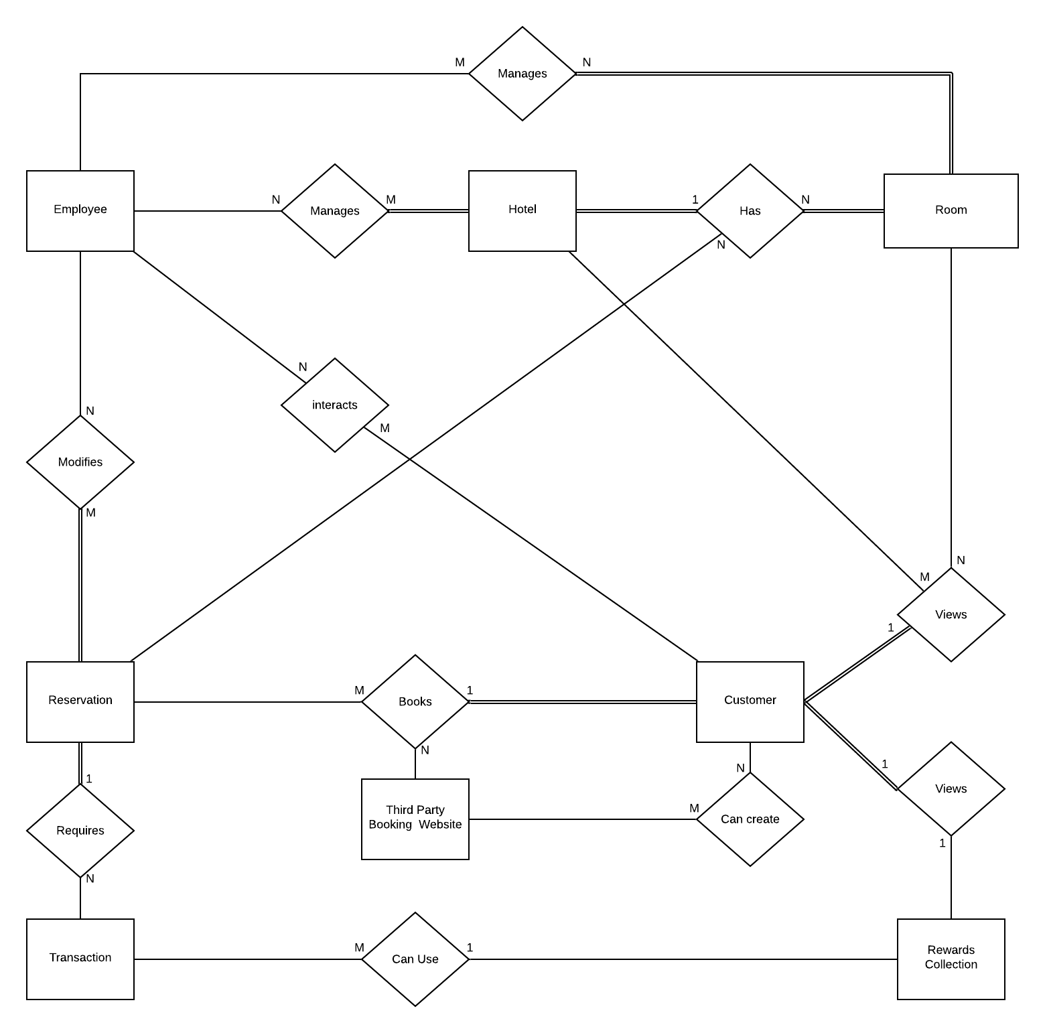
Milestone 2-3 - Complete ERD
Our revised ERD complies with our updated entities.
We changed the format of our ERD to match the qualities and aspects of a proper ERD.
Also, we changed the attributes of many of our entities.
Monier

Slide 18
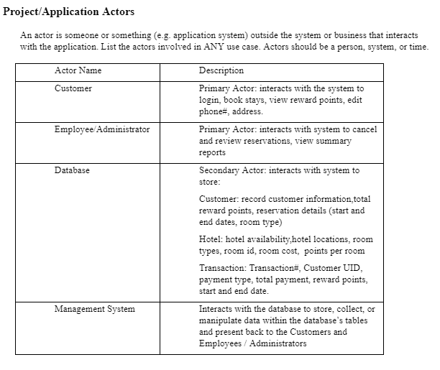
Milestone 2 Use Case Summary - Actors
Four Actors
Primary Actors
Employee/Administrator
Customer
Secondary Actors
Database
Management System
Based off inferences and decisions made by group relative to project charter
Khalid

Slide 19
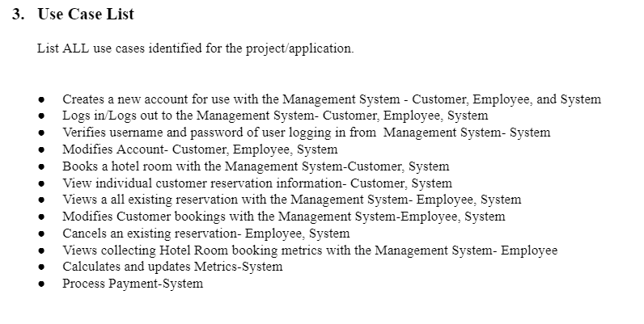
Milestone 2 Use Case Summary - List
Use Cases were defined as “things the system can do”
Our use cases targeted a more specific and detailed understanding of what the system was trying to do.
Khalid

Slide 20
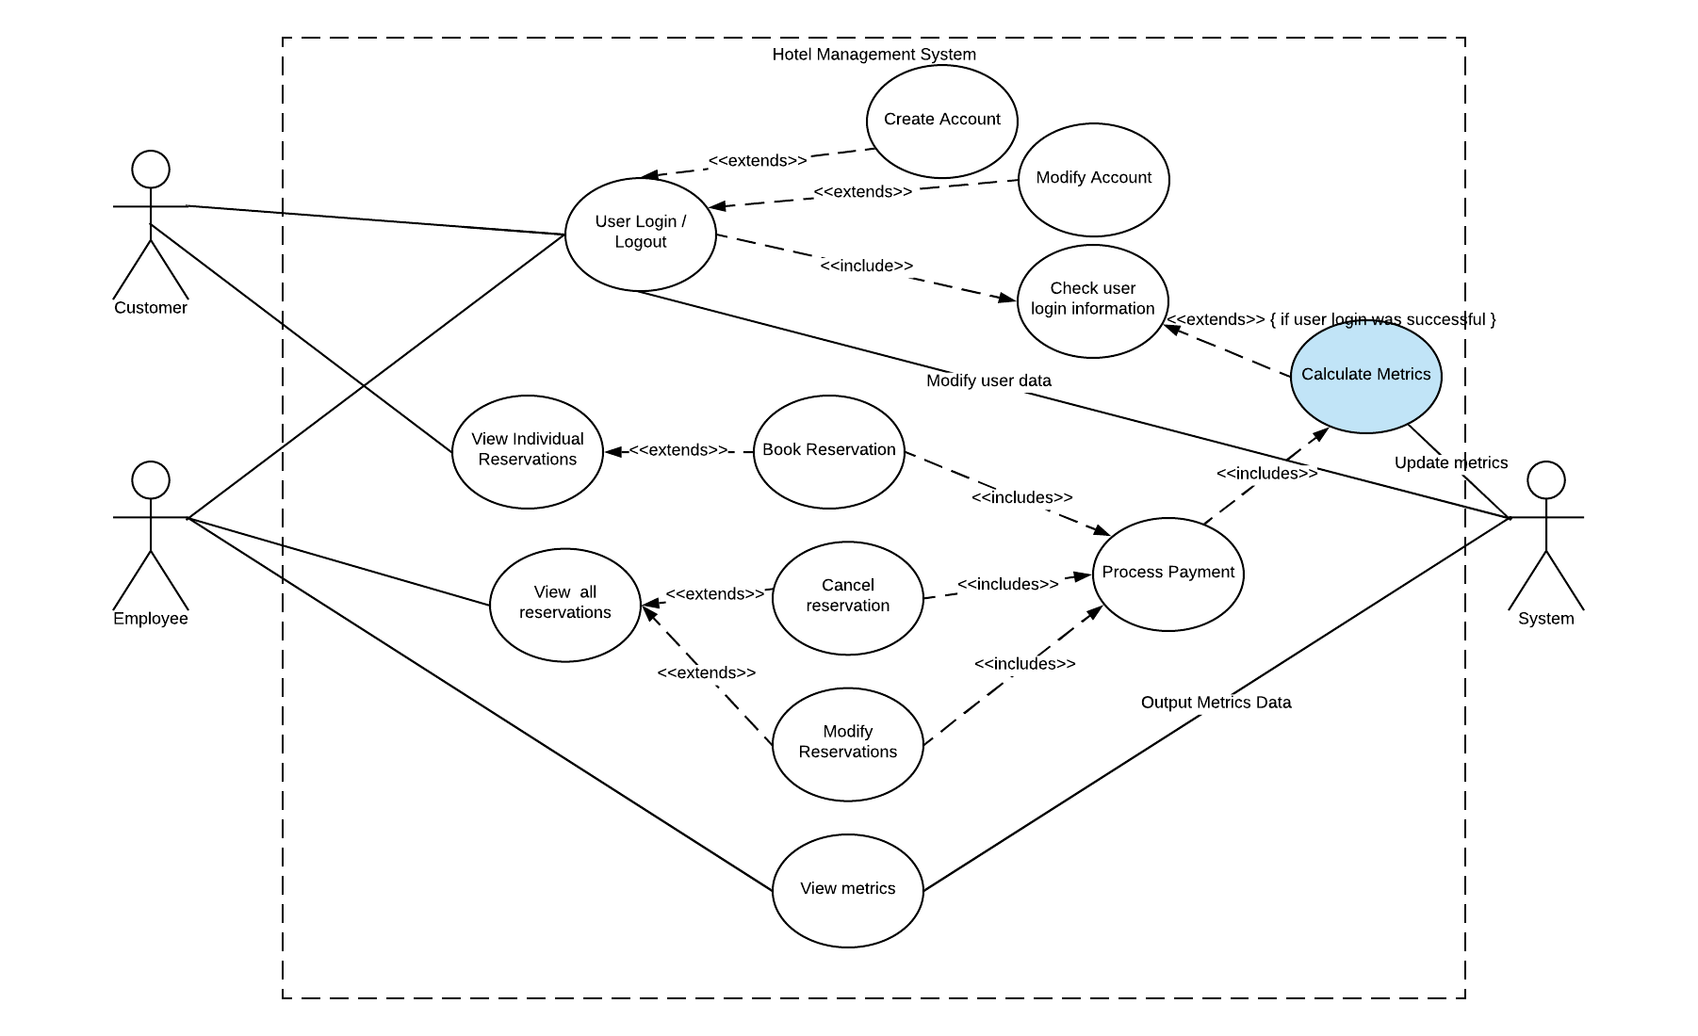
Milestone 2 Use Case Summary - Diagram
Use Case Diagram designed relative to Customer and Employee actions.
Incorporated all our uses cases and how they are interacted with each other.
Shows how customer and employee interact with system.
Khalid

Slide 21
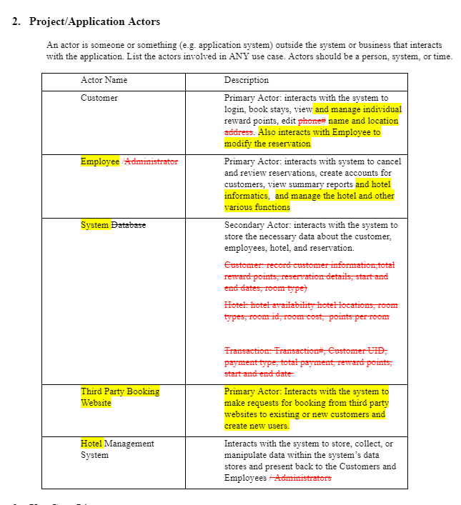
Milestone 3-Use Case Summary - Actors
Five Actors
Primary Actors
Employee
Customer
Third Party Booking Website
Secondary
Database
Hotel Management System
Description
Target more of actors interaction with system
More generalized
Khalid
Notes:
Did not hit all of the actors.
We missed Third Party Booking Website
Our description was inaccurate. We were missing key information regarding each of the Actors interaction. We gave too much detail regarding database which should of been called system. We should generalize and have a larger emphasis on how the actor is interacting with system.

Slide 22
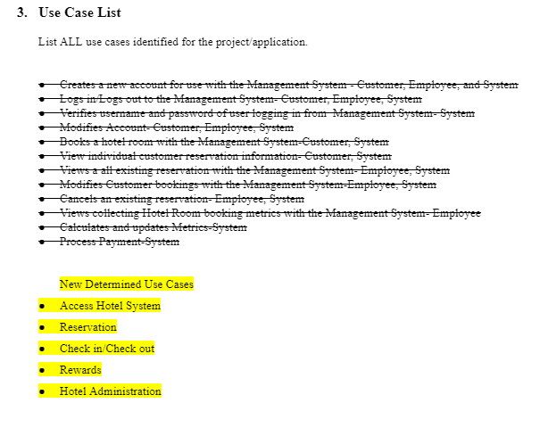
Milestone 3-Use Case Summary - List
Too many uses cases
A good amount of uses case is five
Our defined use cases were too specific
Some of our use cases really fall under the category of flows
More general use cases allow for easier updates in future.
Five Uses Cases
Access Hotel System
Reservation
Check in/Check out
Rewards
Hotel Administration
Khalid
Notes:
After speaking with professor stiener we realized we have way too many use cases and that some of our use cases really fell as flows under the generalized use cases. Five was the recommended amount from professor stiener. Our use cases were also way too specific and needed to be simplified. Also, generalized use cases allow for easier updates in the future.

Slide 23
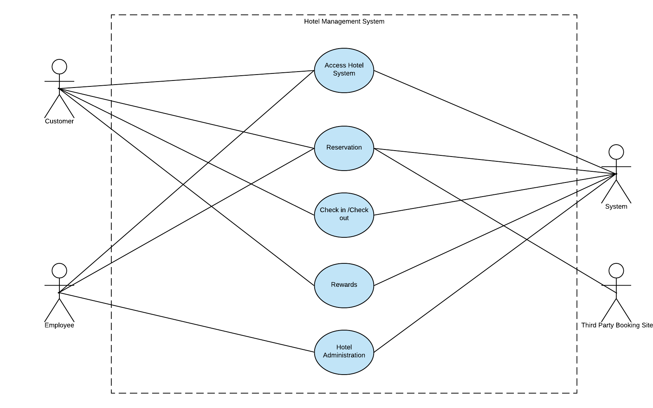
Milestone 3-Use Case Summary - Diagram
Simplified from previous
No flows. We had flows incorporated in our use case Diagram
Too many use cases
Optimal amount of use cases
Actors
Shows how the actors interact with the use cases
Actors can access specific use cases
Khalid
Notes:
Simplieifed from previous use case diagram. Our old one had way too many use cases. Shows the relationship between all the actors and uses cases and defines it as the hotel management system.

Slide 24
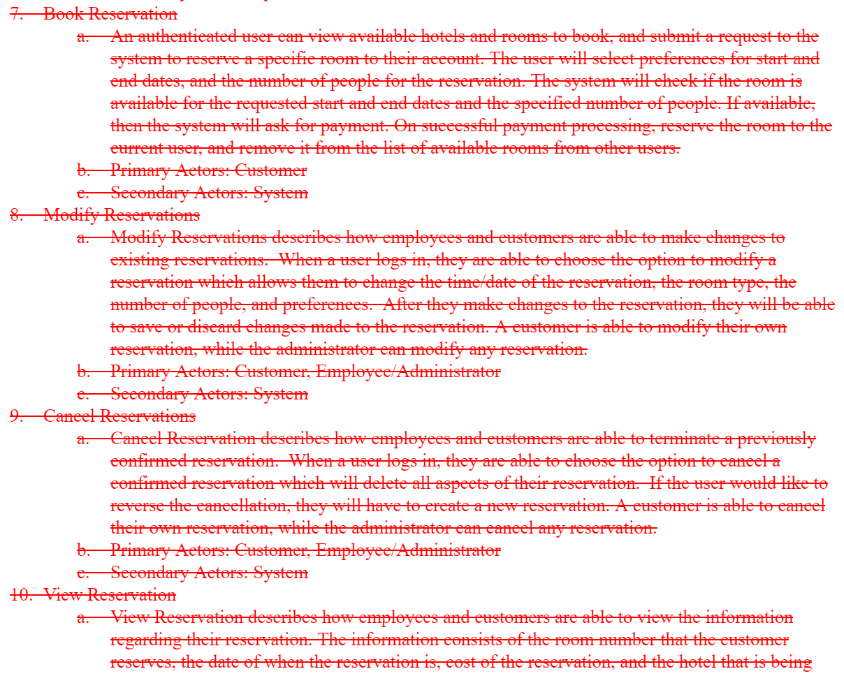
Single Use Case Explanation - Reservations
Originally thought to be a simple case, but quickly expanded once we found flows that followed after basic step but didn’t fit under other use cases
As the use case was built out, we realized we also needed to handle refunds on transactions and room upgrade cases
Point awards were thought to go under the Rewards use case, but to have them applied during or after a transaction made the most sense
Jeff

Slide 25
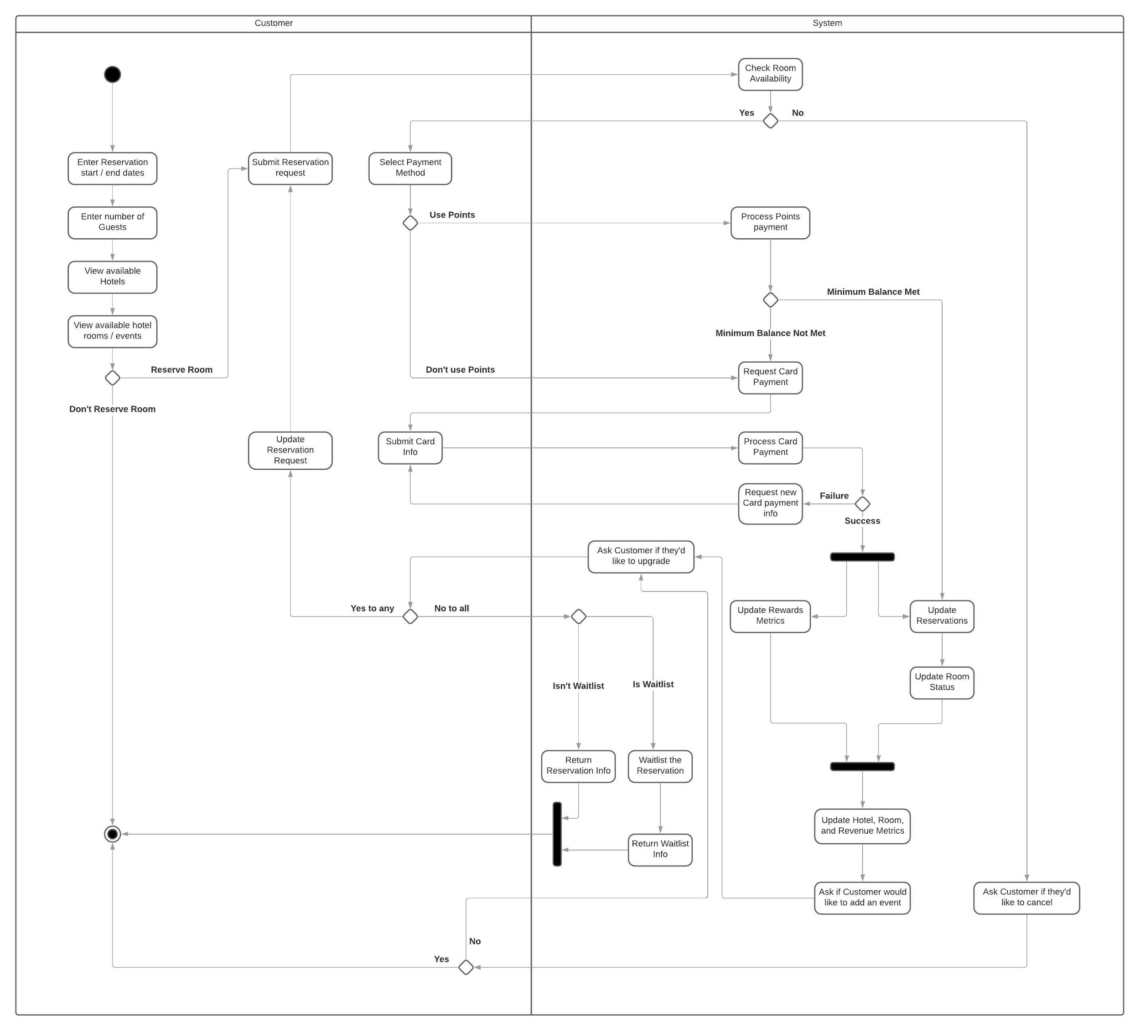
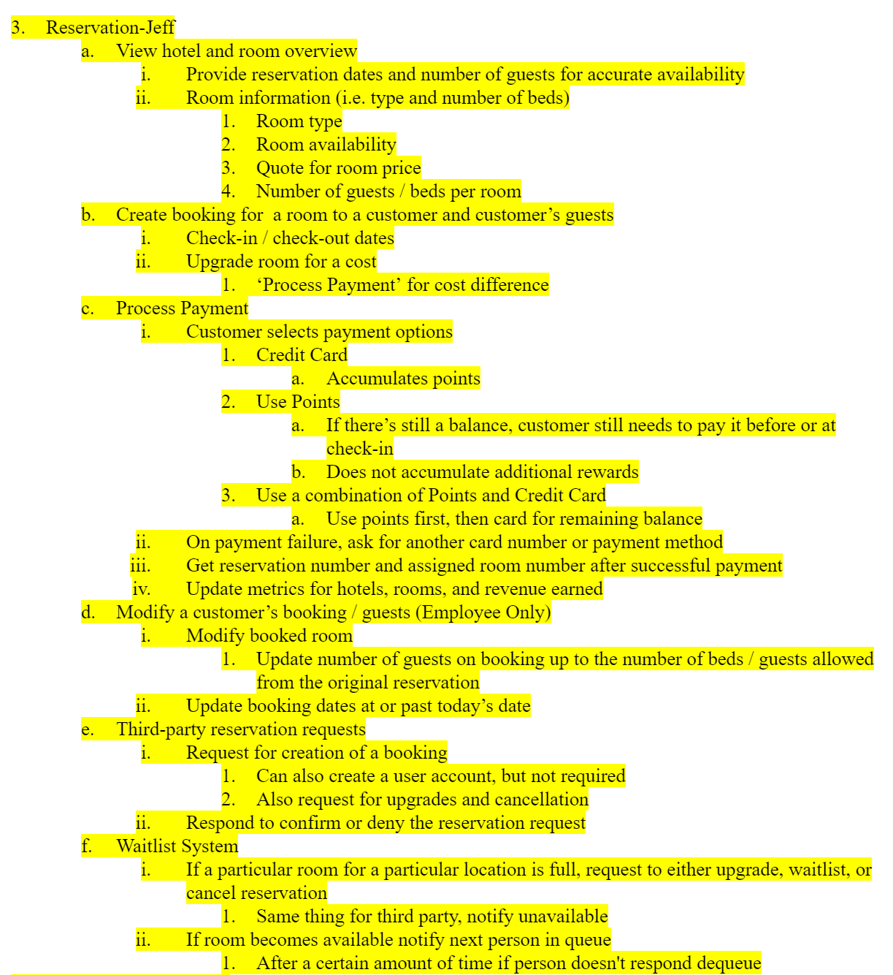

Slide 26
Easiest Parts
Signing off on the Project Charter
As a team we were ready to jump in to the project, though we didn’t have a good sense of just what was required
Use Case Summary
Once we had our 2nd version, it was easy to gather information from notes and put them in as flows
Use Case Specification
We spent a lot of time creating/revising our Use Case Summary, which allowed for use to have good understandings of how each use case will work. It made it easy and clear to create use case specifications for each Use Case.
Monier

Slide 27
Hardest Parts
Creating accurate activity diagrams that resemble our use cases properly.
Tedious to create and develop
Developing and identifying the general use cases
Classifying which flows should go under which use case
Creating initial Use Case Summary
We were unfamiliar with how to approach each use case, so putting the initial version of our Use Case Summary proved to be difficult.
Creating a proper ERD
Our initial ERD was similar to a class diagram, so we had to start from scratch and develop a proper ERD that fit our new entities.
Creating flows for the Reservation use case
The Reservation use case was quite complex as it has to handle transactions, booking information, rewards, and refunds.
Monier

Slide 28
Lessons Learned
Seek stakeholder feedback while creating use cases and diagrams.
We ran into issues with our use cases and diagrams. After discussing with Professor Steiner, we decided it would be best to redo most of our use cases and diagrams.
Identify valuable use cases rather than having more, less-valuable use cases.
Work ahead of schedule
We had a time crunch when working on Milestone 3 and had to ask for an extension. To prevent this in the future, we could plan ahead by working on the project at least 4-5 times per week even if it involves shorter sessions.
In our time-tracking document, we also have stretches of days where no work is completed towards our project -- we could be more efficient with spacing out our work evenly
Monier

